Slide 1
book2
File created on: 11/9/2023 12:48:53 PM

Slide 2
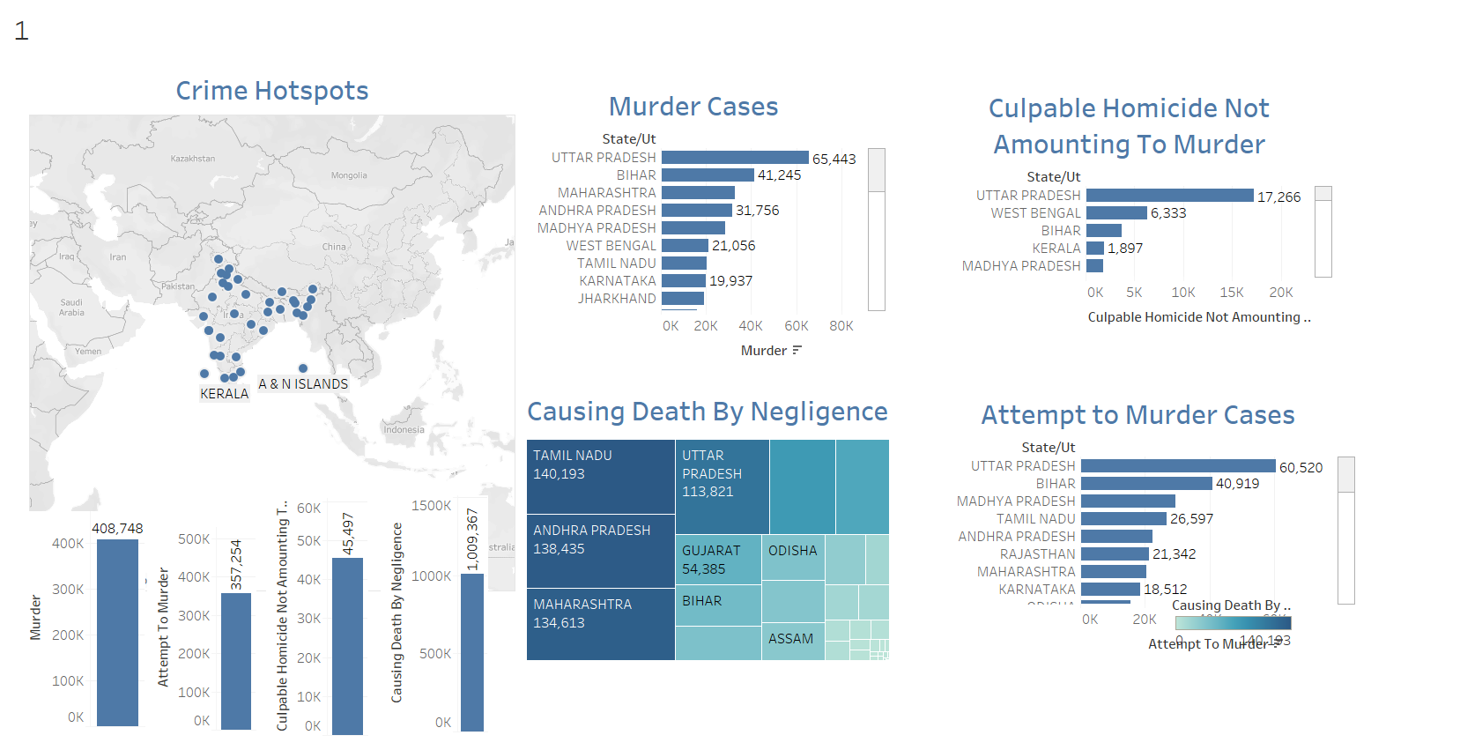

Slide 3
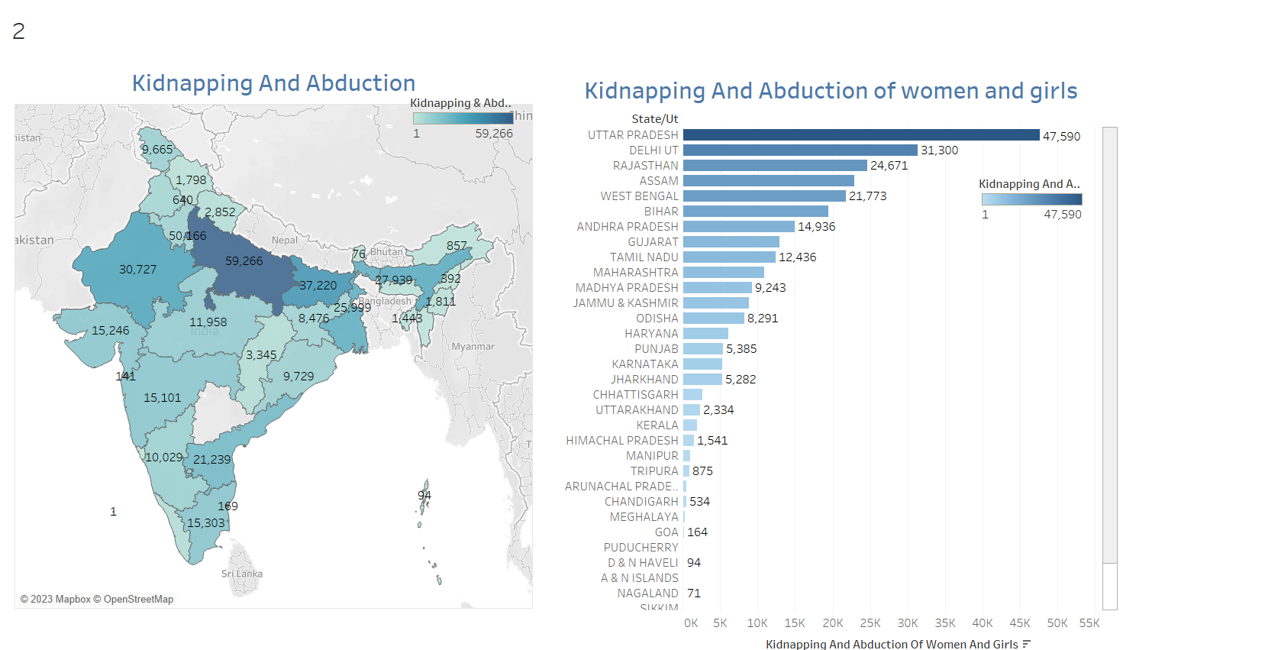

Slide 4
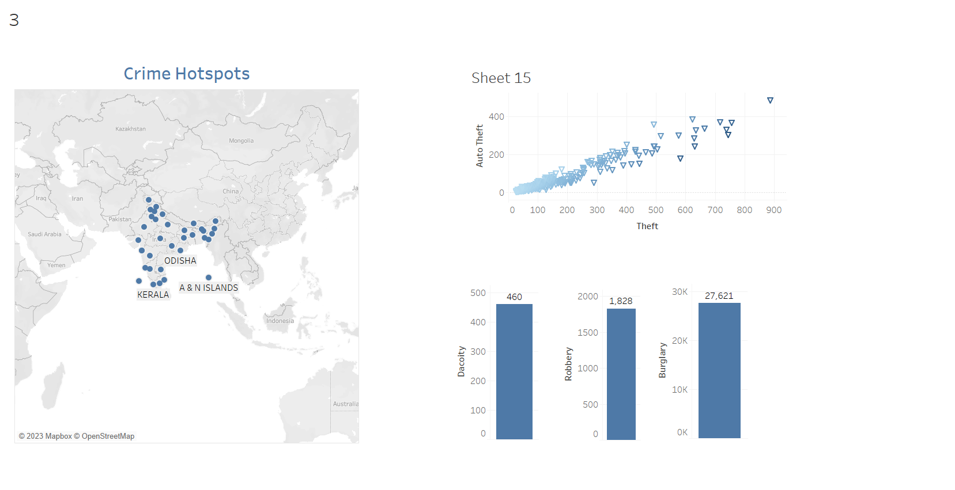

Slide 5
